Slide 1
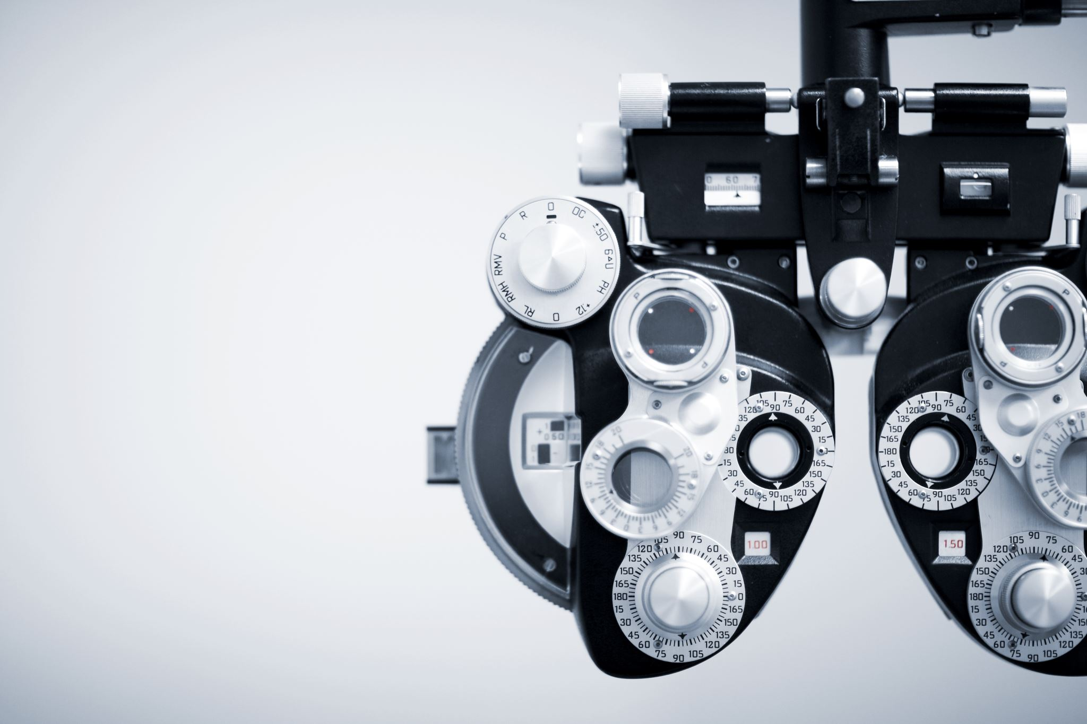
Computer Vision
Computer Vision Fundamentals

Slide 2
Object Detection
Object detection is a phenomenon in computer vision.
The task of classifying and localizing multiple objects in an image.
Some of the objects detected include people, cars, chairs ……

Slide 3
Object Detection
We all know about the image classification problem. Given an image, the Net finds out the class to which the image belongs.
Localizing an object in a picture means predicting a bounding box around the object and can be expressed as a regression task.

Slide 4
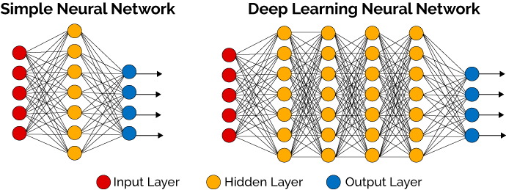
Object Detection - Example
raw image
416*416
image labeling
(C, X,Y, W, H)
model
• Each item should be a tuple of the form :
(images,
(class_labels, bounding_boxes) )
(C, X,Y, W, H)
image result

Slide 5
Object Detection - Example

Slide 6
Object Detection - Example TL

Slide 7
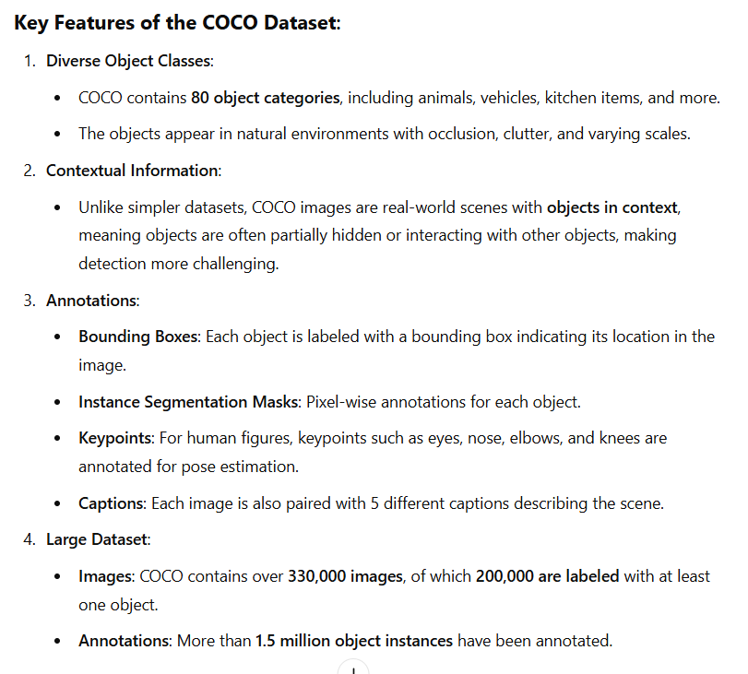
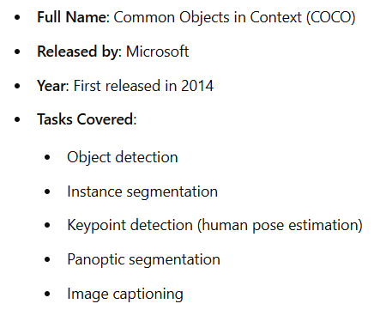
COCO Dataset

Slide 8
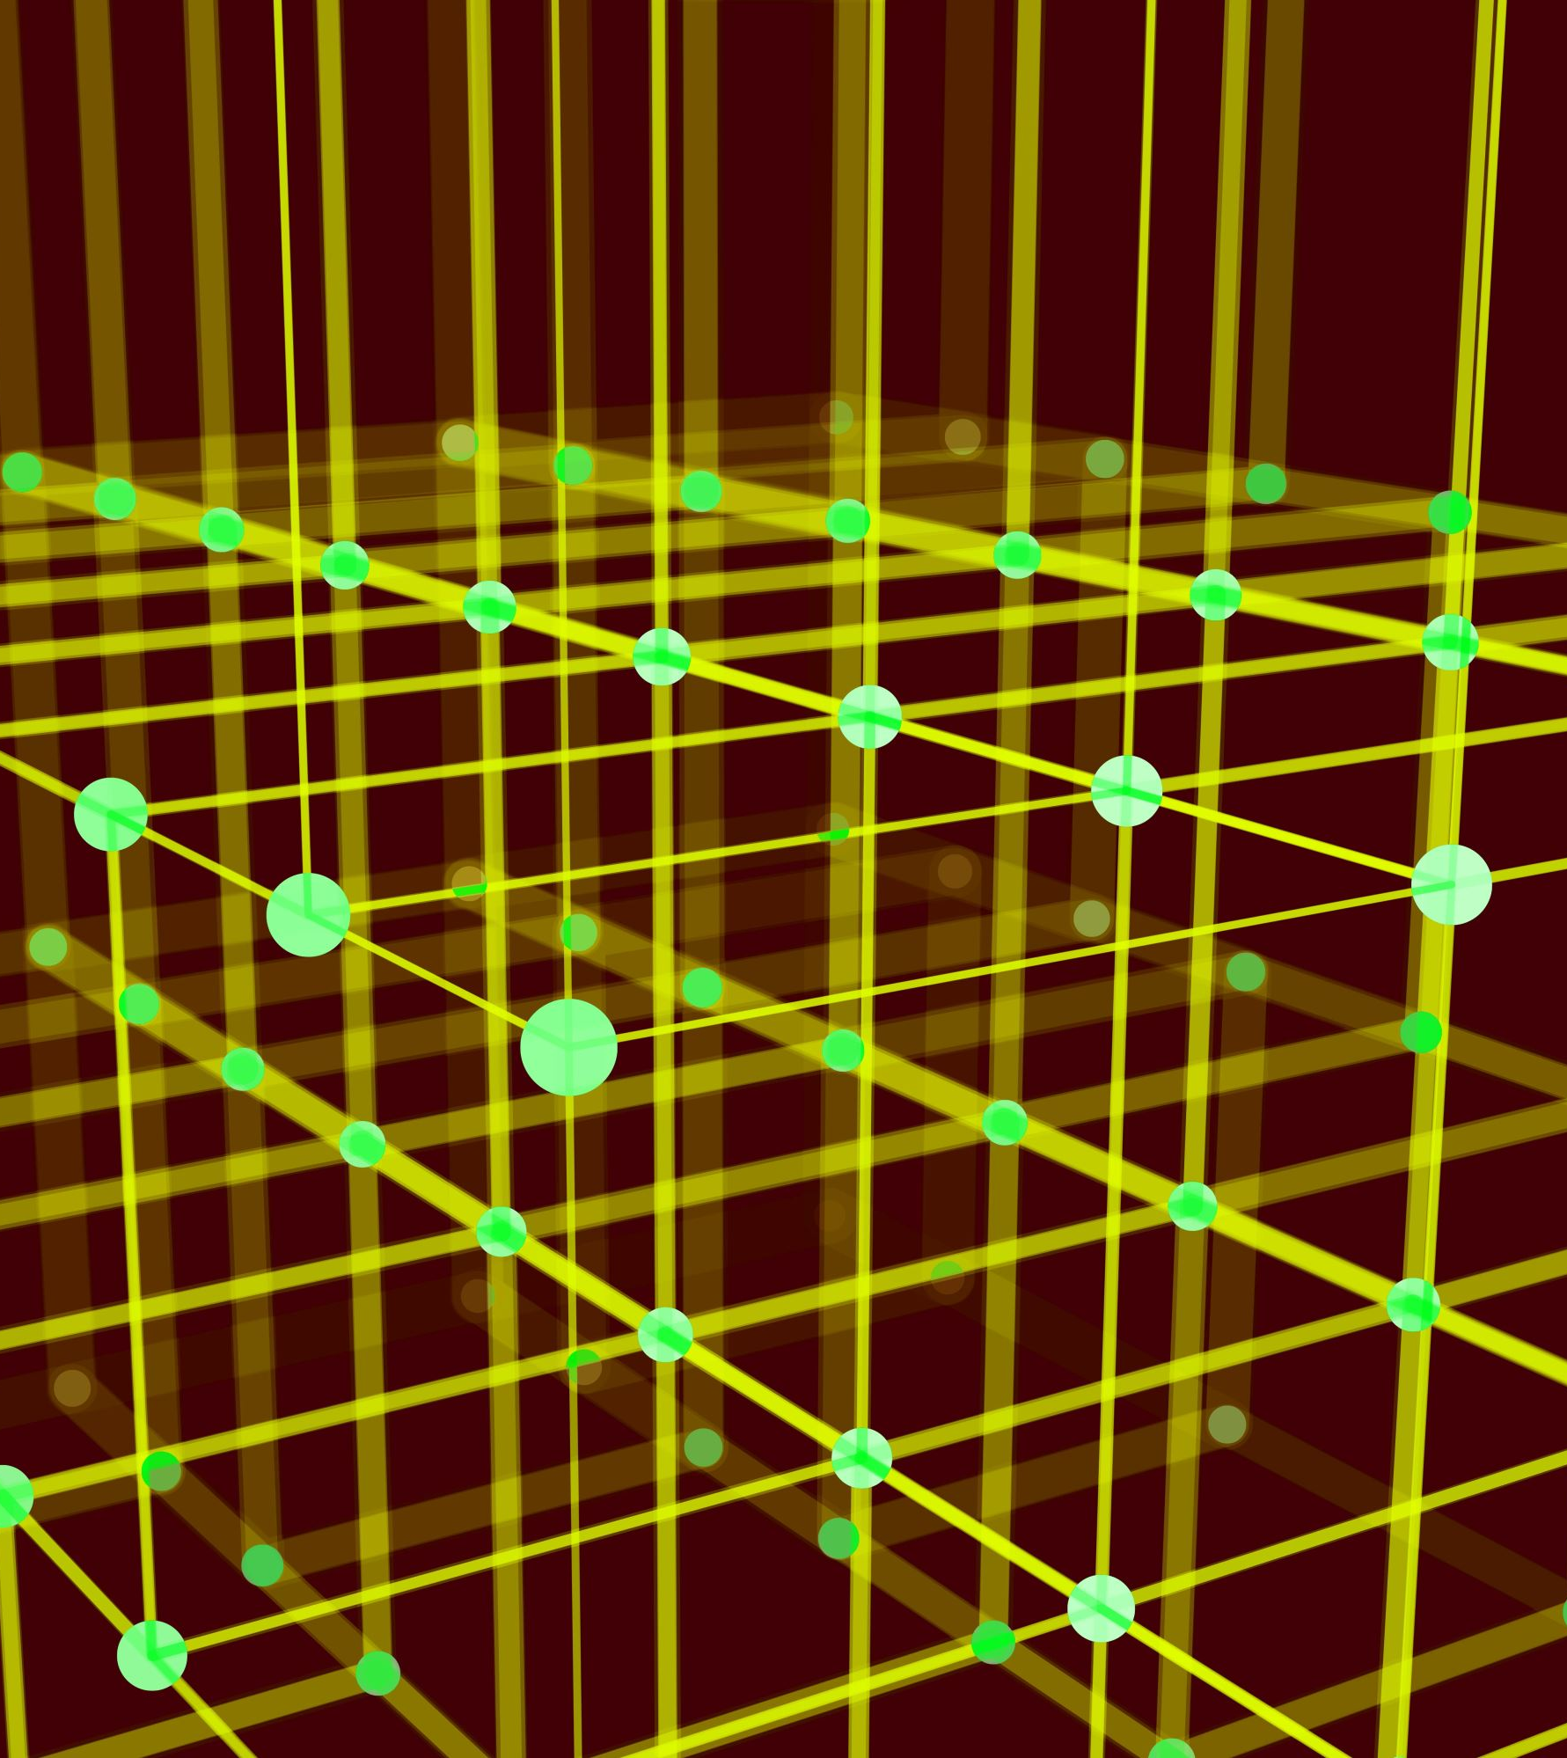
Object Detection Algorithms
YOLO (You Only Look Once) Version 3,4,5,6,7,8,9,10,11,12, 26, World
Single Shot Detector (SSD)
Fast R-CNN
Faster R-CNN
DINOv3

Slide 9

What Is Yolo?
You Only Look Once (YOLO) is an algorithm that uses convolutional neural networks for object detection.
It is one of the fastest object detection algorithms out there.
It is a very good choice when we need real-time detection, without loss of too much accuracy.

Slide 10
Yolo Steps
Backbone : Refers to the feature-extraction architecture.
Tiny YOLO has only 9 convolutional layers, so it’s less accurate but faster and better suited for mobile and embedded projects.
Darknet53 ( The backbone used in YOLOV3) has 53 convolutional layers, so it’s more accurate but slower.
In YOLOv4, backbones can be VGG, ResNet, SpineNet, EfficientNet, ResNeXt, or Darknet53.

Slide 11
Yolo Steps
Neck
additional layers between the backbone and the head (dense prediction block), its purpose is to add extra information in the layers.
Head
The head block is the part used to: locate bounding boxes and classify what’s inside each box.

Slide 12
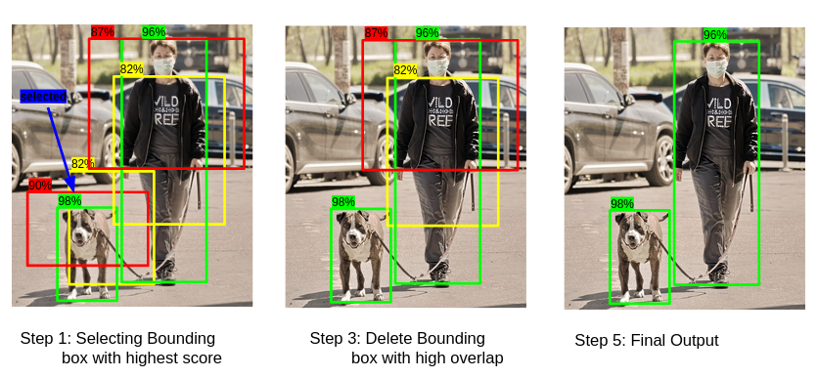
Non-Maximal Suppression
Non-max suppression is the final step of these object detection algorithms and is used to select the most appropriate bounding box for the object.
Filter: Discard all bounding boxes with a confidence score below a set threshold.
Sort: Sort the remaining boxes in descending order by their confidence scores.
Select: Pick the box with the highest score, save it as a final prediction, and remove it from the list.
Compare (IoU): Calculate the Intersection over Union (IoU) between this selected box and all other remaining boxes.
Suppress: Remove any box from the list that has an IoU higher than your overlap threshold (meaning it overlaps too much with the selected box).
Repeat: Loop back to Step 3 until no boxes are left in the list.

Slide 13
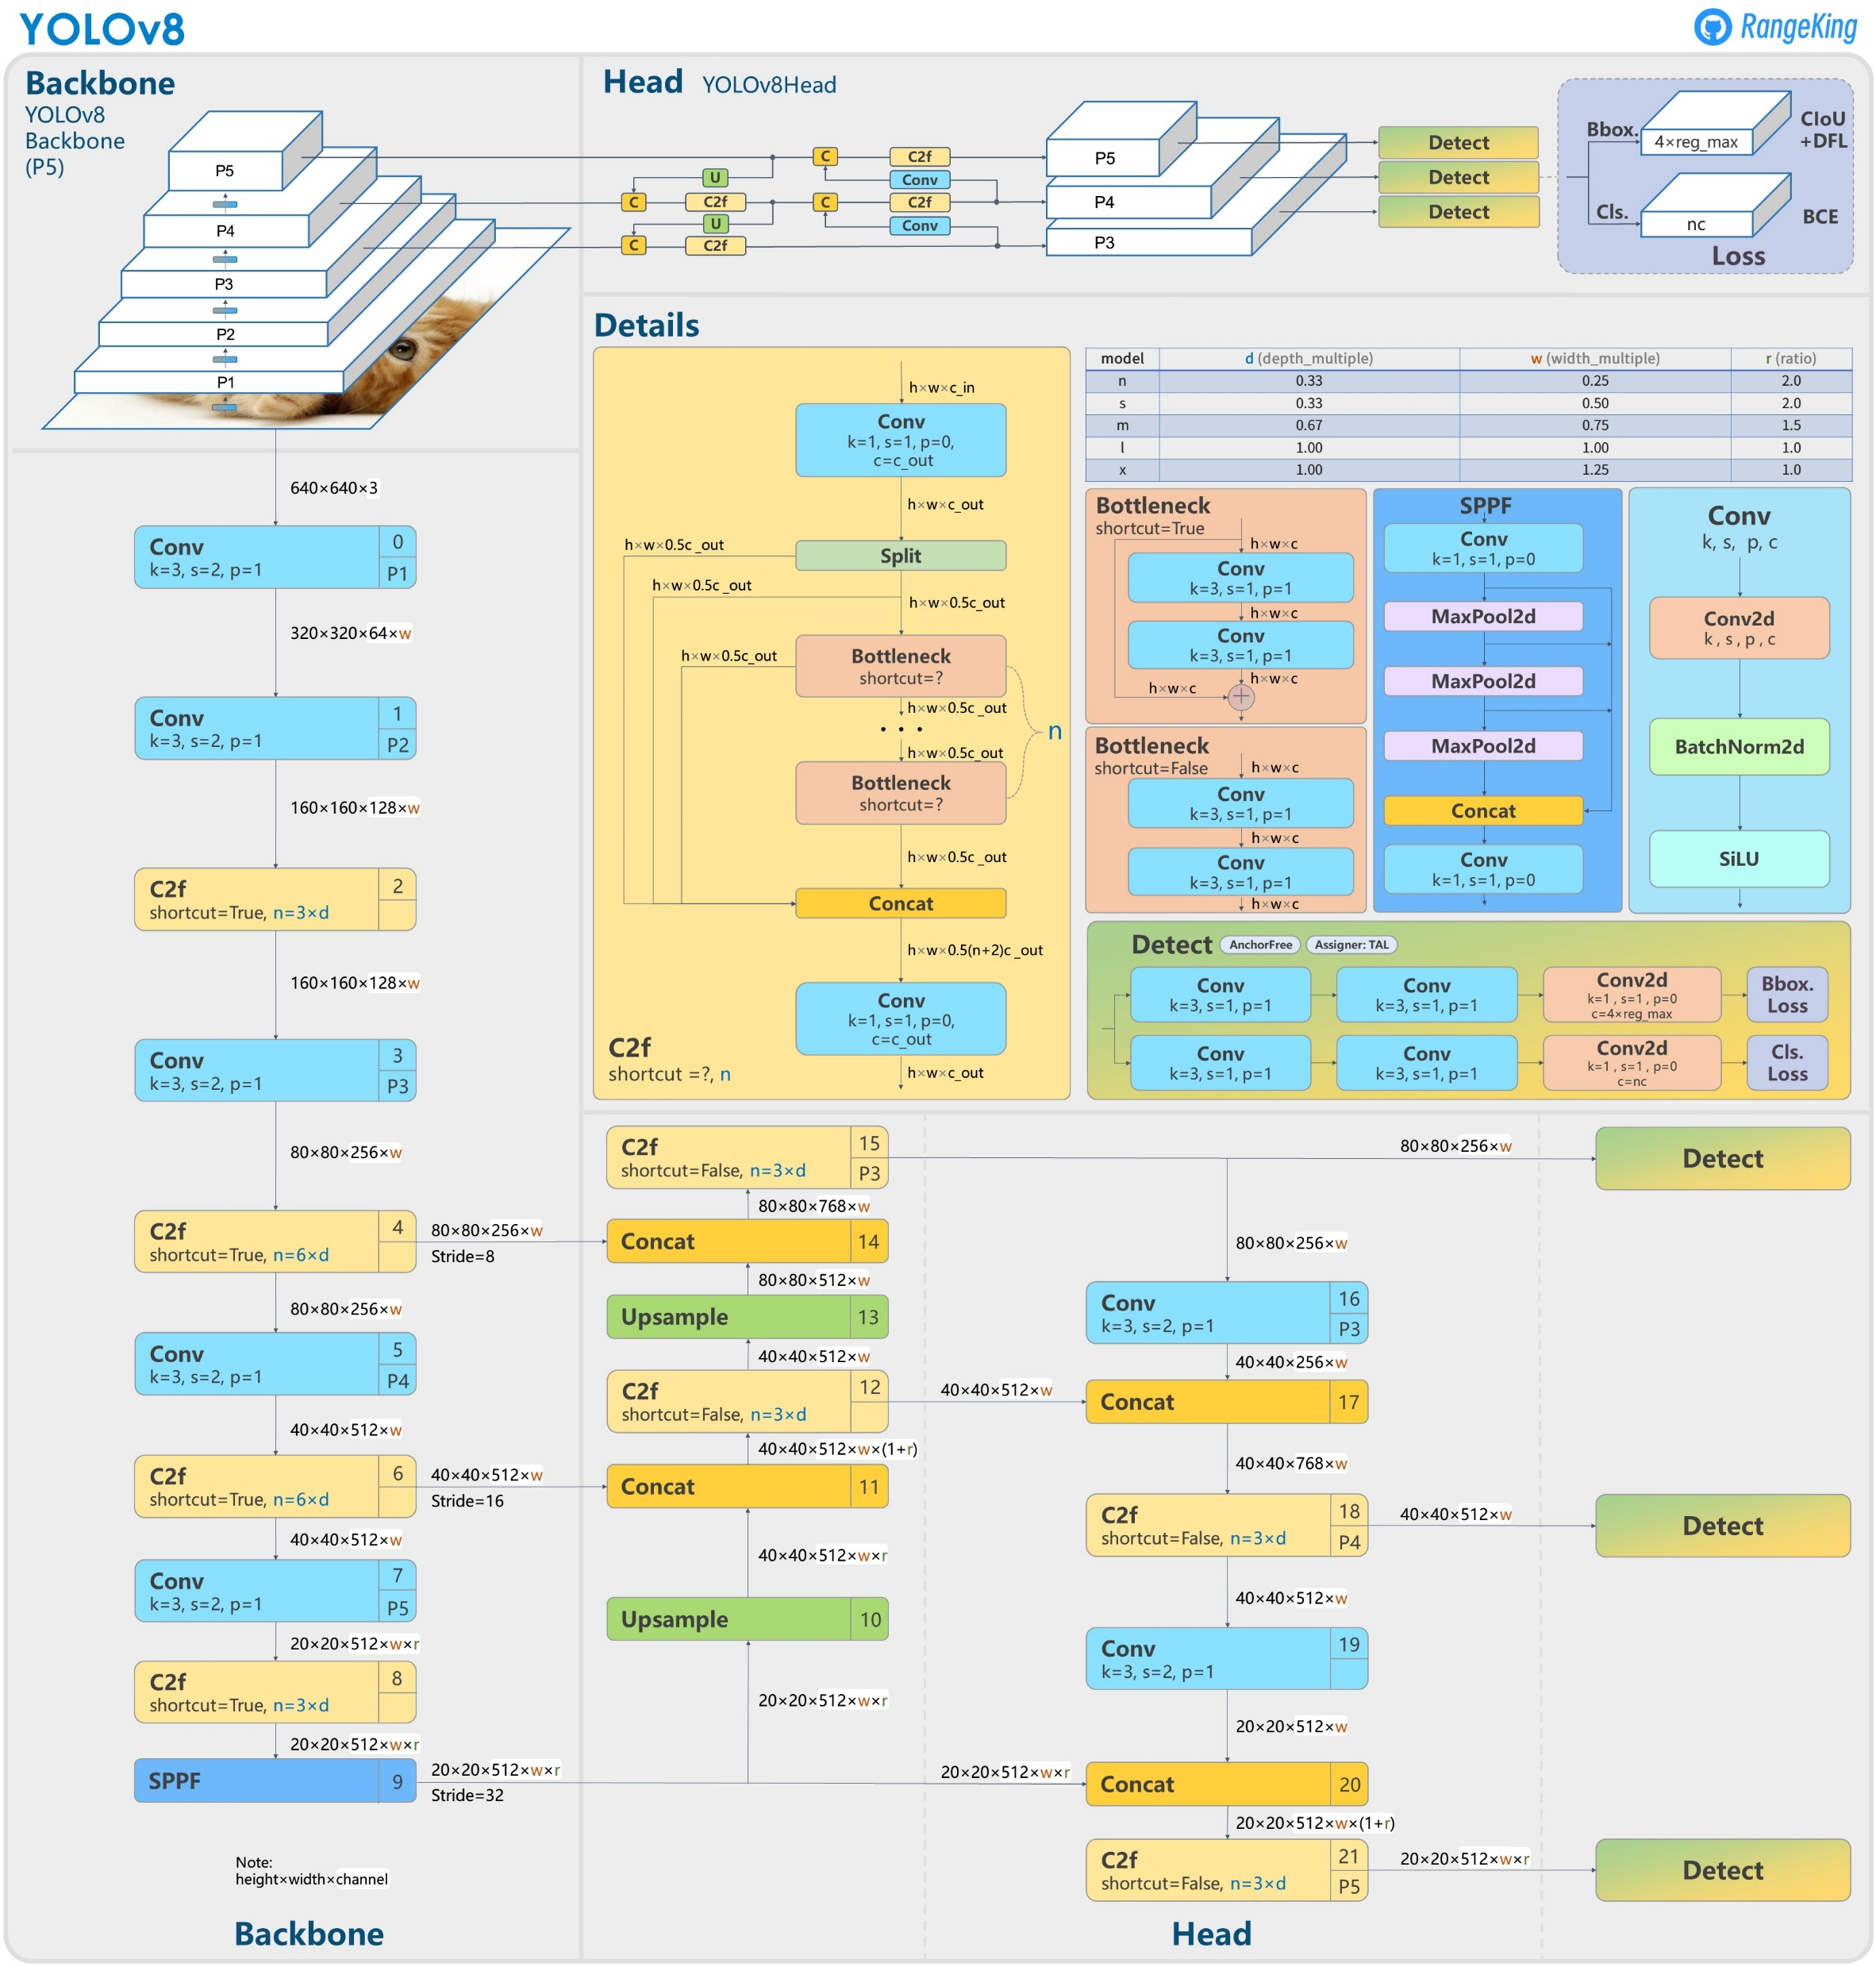
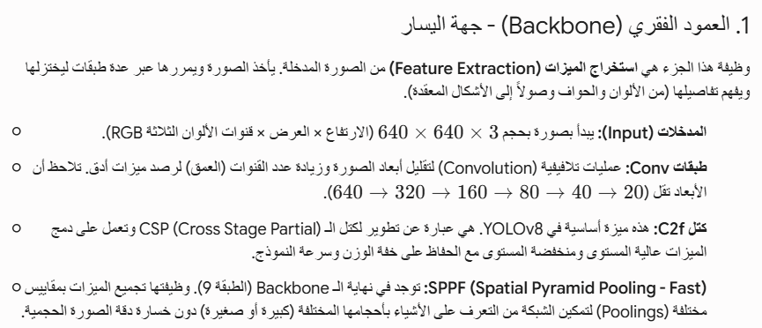
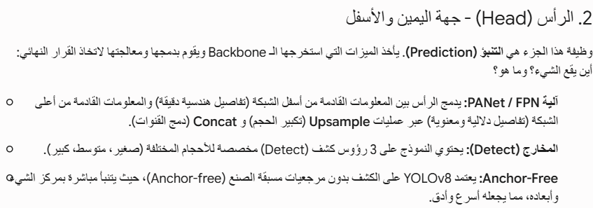
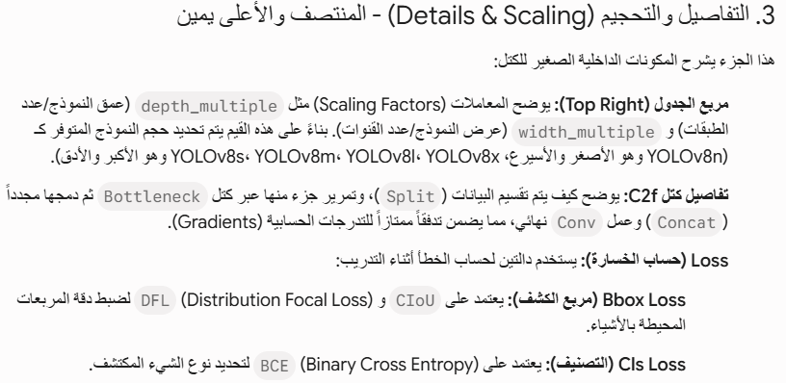
Architecture Of YoloV8
GitHub - ultralytics/ultralytics: NEW - YOLOv8 🚀 in PyTorch > ONNX > OpenVINO > CoreML > TFLite

Slide 14
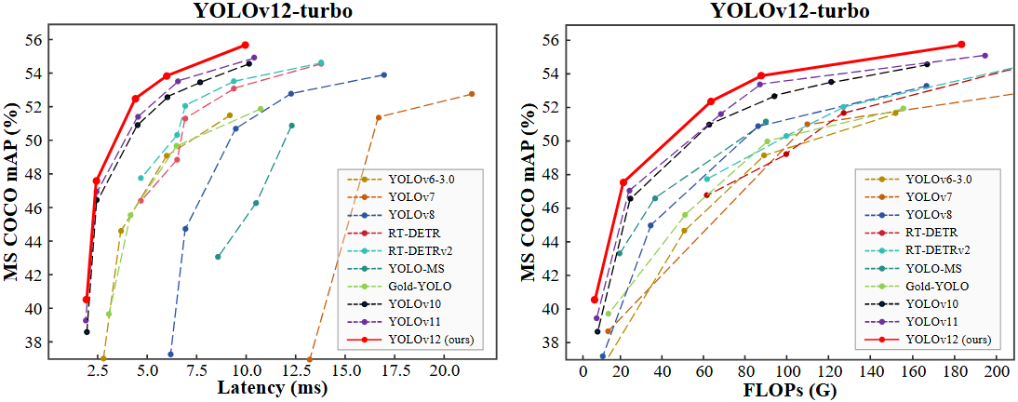


YOLO
The number of these operations is called FLOPs.
For example:
A small model like YOLOv5s might need 17 GFLOPs (17 billion operations).
A larger model like YOLOv5x might need 140+ GFLOPs.

Slide 15
Evaluate Object Detection Model
(Mean Average Precision [mAP])

Slide 16
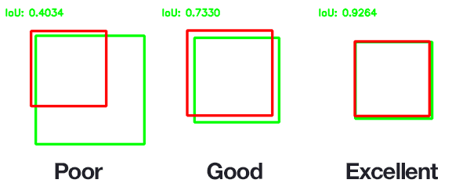
How To Evaluate Object Detection Model?
• The MSE often works fairly well as a cost function to train the model, but it is not a great metric to evaluate how well the model can predict bounding boxes.
• The most common metric for this is the Intersection over Union (IoU).
Coding : tf.keras.metrics.MeanIoU

Slide 17
Mean Average Precision ( mAP )
mAP is a performance metric commonly used in object detection to evaluate how well a model detects objects in an image.
It measures the average precision (AP) over a set of Intersection over Union (IoU) thresholds.
In COCO evaluation, the IoU threshold ranges from 0.5 to 0.95 with a step size of 0.05 represented as AP @ [0.5:0.05:0.95]
mAP is computed by calculating the AP for each class and averaging the results across all classes.

Slide 18
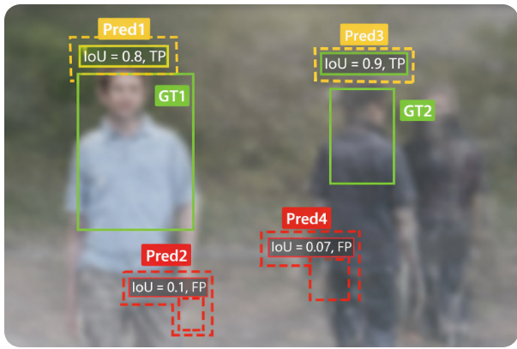

Mean Average Precision (mAP)
Assume we have two ground truth objects (GT1, GT2).
We make four predictions with confidence scores and IoU results.
Table Example:
Prediction | Confidence | IoU | TP/FP (IOU >=0.5)
Pred1 | 0.9 | 0.8 | TP
Pred2 | 0.07 | 0.1 | FP
Pred3 | 0.7 | 0.9 | TP
Pred4 | 0.05 | 0.07 | FP

Slide 19
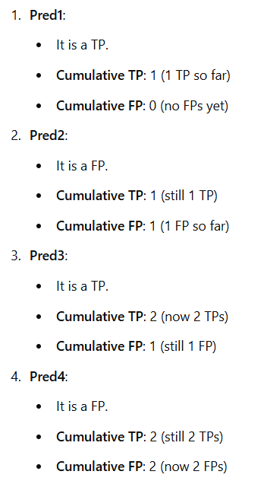
Show how to calculate Cumulative TP and Cumulative FP at each step using the predictions:
Prediction | TP/FP | Cumulative TP | Cumulative FP
Pred1 | TP | 1 | 0
Pred2 | FP | 1 | 1
Pred3 | TP | 2 | 1
Pred4 | FP | 2 | 2

Slide 20
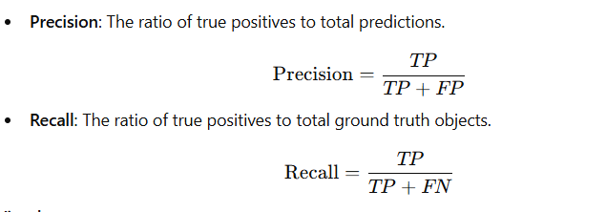
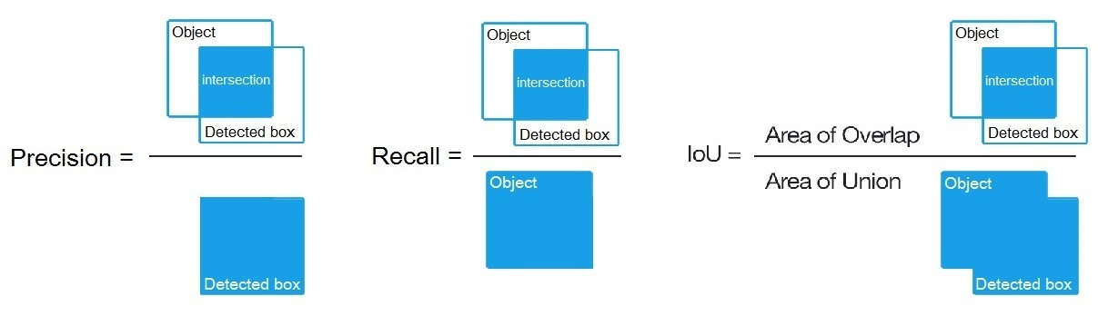
True Positive (TP): Correctly detected object with IoU ≥ threshold.
False Positive (FP): Incorrectly detected object or wrong class.
False Negative (FN): Ground truth object not detected by the model.
IoU (Intersection over Union): Measures the overlap between the predicted bounding box and the ground truth box.

Slide 21
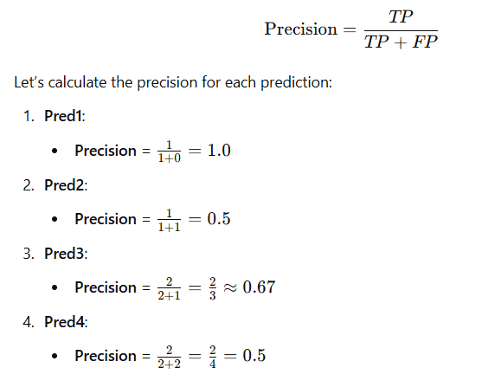
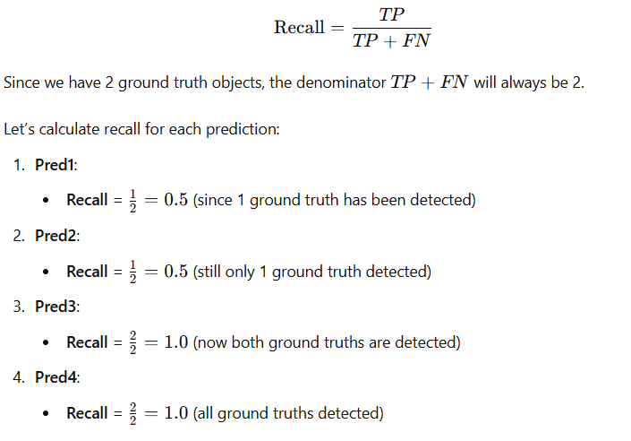
Prediction | TP/FP | Cumulative TP | Cumulative FP | Precision | Recall
Pred1 | TP | 1 | 0 | 1.0 | 0.5
Pred2 | FP | 1 | 1 | 0.5 | 0.5
Pred3 | TP | 2 | 1 | 0.67 | 1.0
Pred4 | FP | 2 | 2 | 0.5 | 1.0

Slide 22
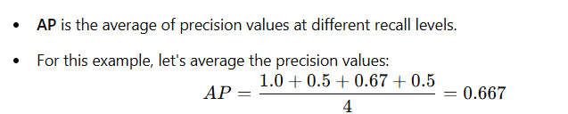
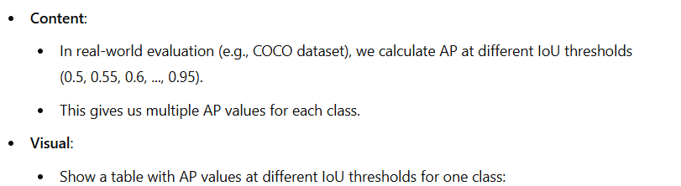
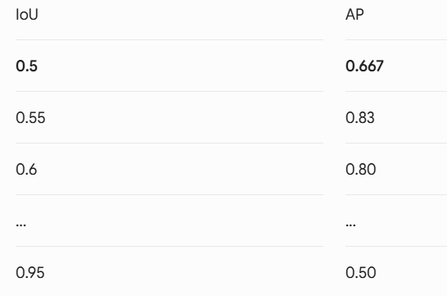
Average Precision (AP)
Prediction | Precision | Recall
Pred1 | 1.0 | 0.5
Pred2 | 0.5 | 0.5
Pred3 | 0.67 | 1.0
Pred4 | 0.5 | 1.0

Slide 23
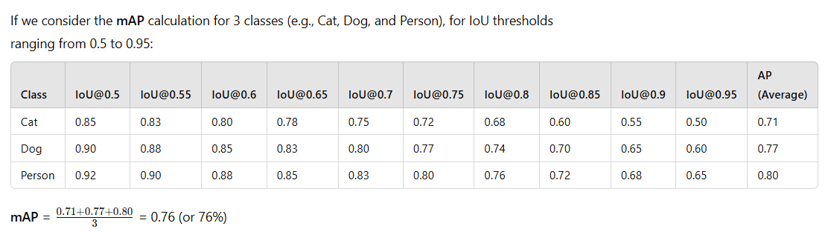
Mean Average Precision (mAP)

Slide 24
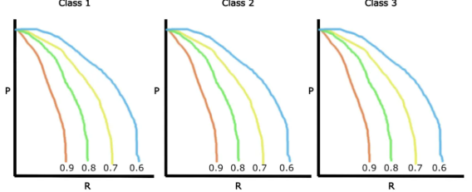
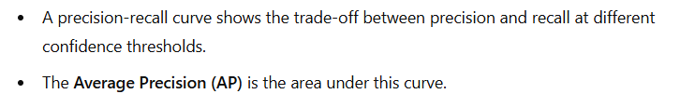
Mean Average Precision ( mAP )
• These precision and recall values are then plotted to get a PR (precision-recall) curve. The area under the PR curve is called Average Precision (AP).
• We draw these precision-recall curves for the dataset split out by class type (for example 3 classes and 6 threshold ranges).

Slide 25
Comparison between Yolo versions
YOLO Version | Year Released | Major Architecture & Innovation Highlights | Native Task Support | Pros & Key Strengths | Cons & Trade-offs
YOLOv8 | 2023 | Anchor-free split head, C2f blocks, Decoupled detection head. | Detection, Segmentation, Classification, Pose, OBB. | Highly stable, established massive community support, excellent modular toolchain. | Higher parameter count and overhead compared to later streamlined versions.
YOLOv9 | 2024 | Programmable Gradient Information (PGI) & Generalized Efficient Layer Aggregation Network (GELAN). | Detection, Segmentation, Classification, Pose. | Massive reduction in information loss during deep layer feature extraction. | Higher training memory requirements.
YOLOv10 | 2024 | Consistent Dual Assignments for NMS-free training, holistic efficiency-driven design. | Detection, Segmentation, Classification, Pose. | Zero NMS latency during inference, highly optimized for real-time edge AI. | Slower convergence rates on complex, hyper-custom datasets.
YOLO11 | 2024 | C3K2 blocks, Spatial Pyramid Pooling Fast (SPPF), and C2PSA (Spatial Attention). | Detection, Segmentation, Classification, Pose, OBB. | Outstanding accuracy-to-parameter efficiency, specifically tailored to detect small/obscured objects. | Can experience slight latency bottlenecks on specific low-end CPU configurations.
YOLOv12 | 2025 | Attention-centric design (Area Attention, FlashAttention, R-ELAN). | Detection, Segmentation, Classification, Pose, OBB. | State-of-the-art accuracy gains (+1.2% mAP over YOLO11), large receptive field. | Independent community release; suffers from training instability and high CPU/memory consumption.
YOLO26 | 2025/2026 | Deployment-first design: Permanently removed NMS and DFL; introduces ProgLoss and MuSGD Optimizer. | Unified native support for all 5 major vision tasks. | Eradicates export friction on low-power devices, incredibly fast inference speeds, flawless edge-AI optimization. | Stricter requirement for fine-tuning configuration to achieve optimal convergence weights.

Slide 26
When use ?
Think of YOLOv8 like a Toyota Corolla—it might not have the cutting-edge hyper-tech of a prototype sports car (like YOLOv12 or YOLO26), but it is highly efficient, incredibly reliable, easy to fix, and everyone knows how to drive it
Choose YOLO26 if you want maximum speed, low latency, and smooth edge/CPU deployment.
Choose YOLO11 if you want the most stable, standard, all-around production model.
Choose YOLOv12 only if you are doing deep research or have massive GPU compute power and need the most best accuracy.

Slide 27
Computer Vision (CV)
Object Detection
(Labeling Tools)

Slide 28
Image Labeling Tool
Open-source image labeling tool like :
VGG Image
Annotator
LabelImg
OpenLabeler
ImgLab
Roboflow

Slide 29
Image Labeling Tool - Labelimg

Slide 30
Computer Vision
Object detection
Training YoloV8:12 in Custom Dataset

Slide 31
Train YOLO On A Custom Dataset

Slide 32
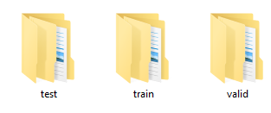
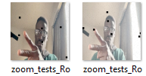
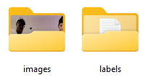


Train YOLOV8:12 On A Custom Dataset
My dataset
Train images
Train set
<class> <x_center> <y_center> <width> <height>
Train labels
label

Slide 33
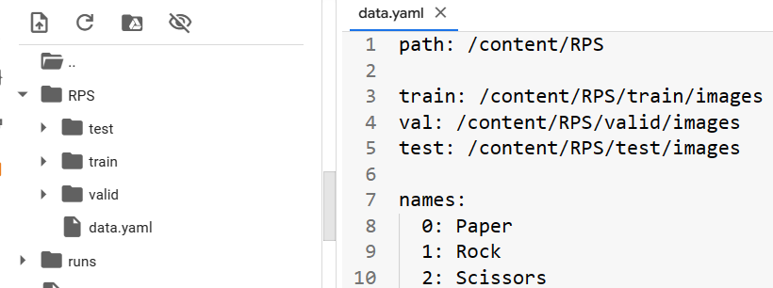
Define Model Configuration And Architecture
We will write a new yaml script file (exp:data.ymal) that defines the parameters for our model like add each class with id and the path of dataset.

Slide 34
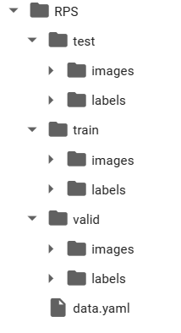
Custom Object Detection Data In YOLOV8:12 Format – Image and label

Slide 35
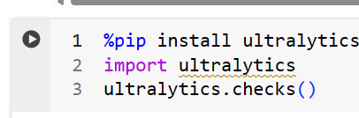
Yolo Training
YOLO11 🚀 NEW - Ultralytics YOLO Docs
YOLOv10 - Ultralytics YOLO Docs
YOLOv9 - Ultralytics YOLO Docs
YOLOv8 - Ultralytics YOLO Docs
• imgsz: define input image size
• batch: determine batch size
• epochs: define the number of training epochs.
• data: set the path to our yaml file
• mode: train or test or valid
• model: specify a custom path to weights.
• task: detect or classify or segment
• Project: path to save weight
• name: name of folder saved

Slide 36
Yolo Training
YOLOv8 | YOLOv9 | YOLOv10 | YOLOv11 | YOLOv12
yolov8n.pt | yolov9t.pt | yolov10n.pt | yolo11n.pt | yolo12n.pt
yolov8s.pt | yolov9s.pt | yolov10s.pt | yolo11s.pt | yolo12s.pt
yolov8m.pt | yolov9m.pt | yolov10m.pt | yolo11m.pt | yolo12m.pt
yolov8l.pt | yolov9c.pt | yolov10l.pt | yolo11l.pt | yolo12l.pt
yolov8x.pt | yolov9e.pt | yolov10x.pt | yolo11x.pt | yolo12x.pt

Slide 37
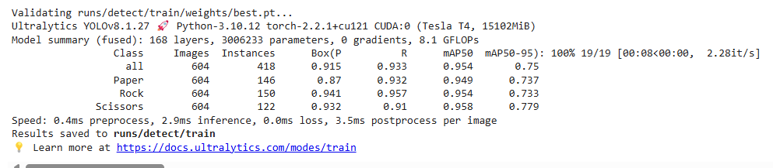
Yolo Training

